Slide 1

Roblox Studio
By Ethan Tsang

Slide 2
What is Roblox Studio?
Roblox Studio is a game engine created by Roblox. Every game on Roblox is made with Roblox Studio.
Roblox games are created with scripts, with the scripting language called “Lua”.
Today, we will learn the basics of Roblox Studio and also learn how to develop a very simple game.

Slide 3
How do we get started?
First, we will open Roblox Studio on our computers.
We will be presented with a login page. I’m sure most of you have Roblox accounts, and I recommend that you use this to sign in. However, for the people who don’t, you will have to sign up for an account at the bottom.
We will then click on “Baseplate” or “Classic Baseplate”. I would recommend the first one.

Slide 4
Let’s create a tool.
In Roblox, we have items that we can use called “Tools”. We will create our own and do something with it. So, let’s create a tool that makes us walk faster.
At the very right, you should have an explorer tab. If not, go to “View” and click “Explorer” on the left.
Hover over “Workspace” and click on the “+” sign. Type in “Tool” and we will insert it.

Slide 5
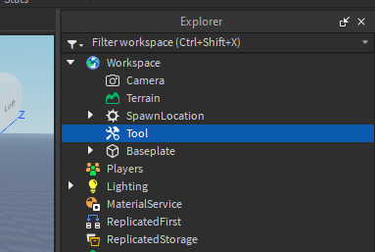
This is what it should look like.
Hover over “Tool” and click on the “+” sign. Type in “Part” and click on the object that’s called “Part”.
Next, click on “Part” and rename it to “Handle”. You can find this in the “Properties” tab. If you don’t have the properties tab, click on “View” and click on Properties.

Slide 6
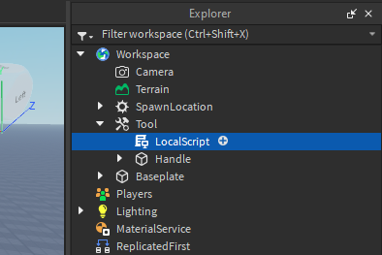
Adding our script.
Hover over “Tool” and type in “LocalScript”, and click on the object called “LocalScript”.
When you’ve added it, double click on it and we will start creating our first script.

Slide 7
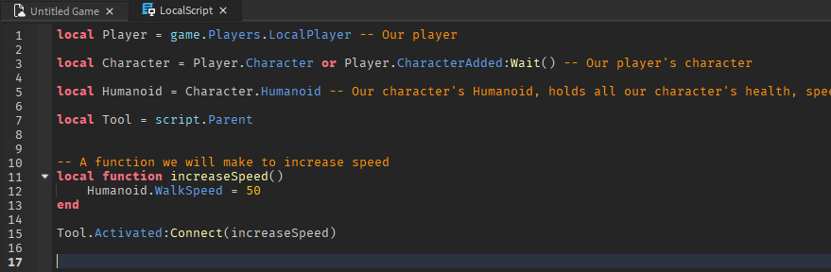
Copy this script.

Slide 8
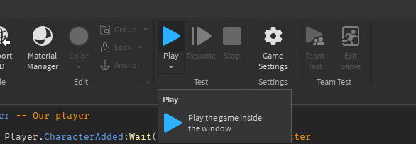
Click “Play” and try it out yourself!

Slide 9
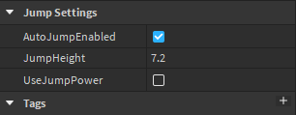
Quick Activity
We made our character’s speed really fast by changing “WalkSpeed”, but can you make it so when you click, your character jumps high?
Here is a hint:

Slide 10
Let’s create an obby.
Most Roblox games are “Obbies”. They are short for obstacle course, and we will create an obby for ourselves to play with.
We will start with the most basic part of an obby, and that is lava.
Hover over “Workspace” and click the “+” sign. Then create a part.
Hover over our new part, and create a script. Make sure it is a script and not a localscript.

Slide 11
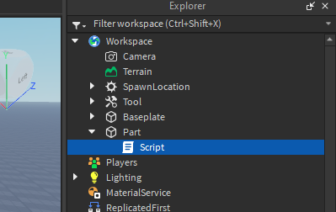
This is what we should have.

Slide 12
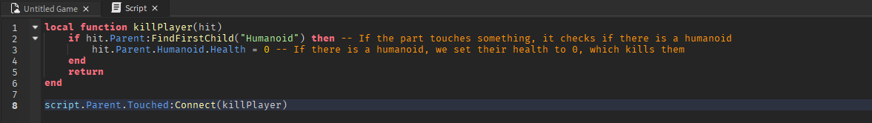
Copy this script.
You may hit play and try it out yourself when you have this done.

Slide 13
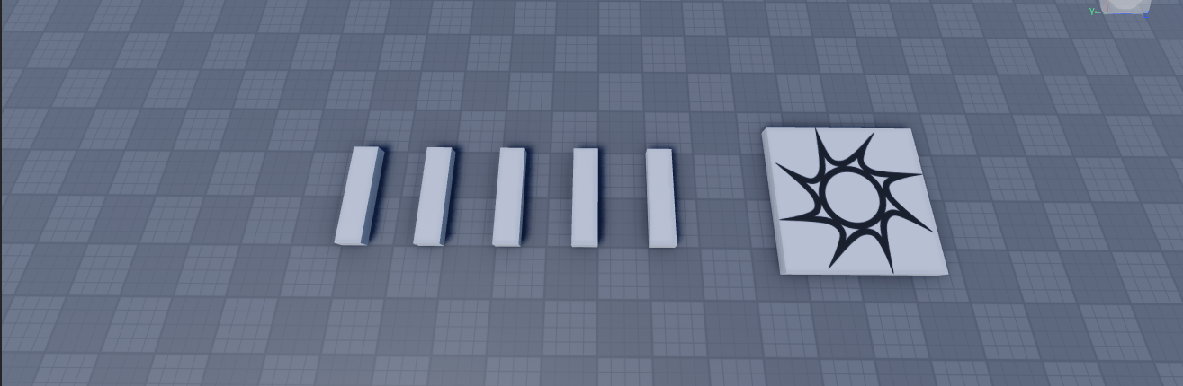
Duplicate and scale the part.
We can click on “Scale” to adjust the size of the part to your liking. After that, we can CTRL + C then CTRL + V the part to duplicate it. This is so you don’t have to create a script every time you want the part.
Next, drag it in a pattern that works for you. Something like this:

Slide 14
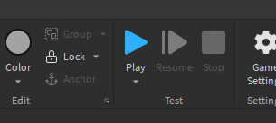
Hit “Play” and try it out yourself!

Slide 15
Activity 1
Could you create a Part where when you touch it, it increases your WalkSpeed?
How about a Part where when you touch it, it heals the player?
Take your time with this and feel free to search up solutions.

Slide 16
Activity 2
In the Roblox Studio folder, you will find a place called “Obby Layout”.
In this place, I have given a simple layout for an obby with parts for you to use.
For this activity, create a challenging obby using the parts and switch with the person beside you.

